Slide 1
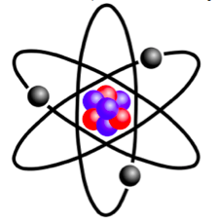
Many electron Atoms: Slater Determinanta

Slide 2
Recapitulation: Many Electron Atoms
, 1-electron Hamiltonians
Inter-electron repulsion terms:
CANNOT be ignored
Hamiltonian is no longer spherically symmetric and the Time-Independent Schrodinger Equation (TISE) cannot be solved using analytical techniques
Numerical methods must be used solve the TISE

Slide 3
Recapitulation: Effective Nuclear Charge
For Helium atom

Slide 4
Recapitulation: Effective Nuclear Charge
Due to Shielding, the electrons do not see the full nuclear charge Z, but Z_{eff} = Z–σ (σ = Shielding Constant)
For Helium atom
There are methods such as Perturbation Theory and Variational Method to estimate Z_{eff}

Slide 5
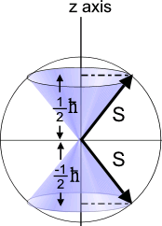
Recapitulation: Spin Angular Momentum
Spin Angular Momentum “S’’
For electrons, s = 1⁄2
“spin-up” (or α) and “spin-down” (or β)

Slide 6
Hydrogen Atom Wavefunctions: Redefined
SPIN ORBITAL: One electron wavefunction containing spatial as well as spin parts

Slide 7
Spin Orbitals and their linear combinations
Two electron system (electron labels: 1 and 2): four spin functions
Which witch is which?
✔
✔
+
Linear combination
1 and 2: indistinguishable
Exchange Operator
Symmetric
Anti-symmetric

Slide 8
6th Postulate of Quantum Mechanics
The complete wavefunction of a system of identical fermions (e.g. electrons) must be anti-symmetric with respect to interchange of all their coordinates (spatial and spin) of any two particles
He atom wavefunction:
What if the two electrons in 1s orbital had same spin?
NOT ALLOWED
Pauli exclusion principle

Slide 9
He Atom Wavefunction
Slater
determinant
Exchange of two rows/ columns: Change in sign
Antisymmetric
If any two rows/columns are same, then the determinant becomes zero.
no two electrons occupy the same spin orbital.
Pauli Exclusion Principle

Slide 10
Many Electron Atoms: Determinantal Wavefunctions
Slater
determinant
1s(3)α(3)
If any two rows/columns are same, then the determinant becomes zero.
no two electrons occupy the same spin orbital.
Pauli Exclusion Principle

Slide 11
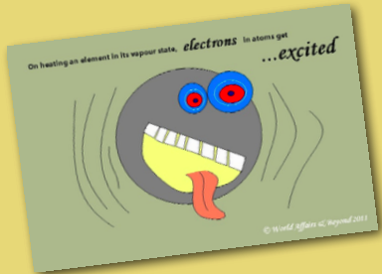
Excited states of many electron atoms
https://drgchemistry.weebly.com/uploads/2/4/8/9/24894932/unit_7_-_atomic_structure.pdf

Slide 12
Spin Orbitals and their linear combinations
Two electron system (electron labels: 1 and 2): four spin functions
Which witch is which?
✔
✔
+
Linear combination
1 and 2: indistinguishable
Exchange Operator
Symmetric
Anti-symmetric

Slide 13
6th Postulate of Quantum Mechanics
The complete wavefunction of a system of identical fermions (e.g. electrons) must be anti-symmetric with respect to interchange of all their coordinates (spatial and spin) of any two particles
He atom wavefunction:
What if the two electrons in 1s orbital had same spin?
NOT ALLOWED
Pauli exclusion principle

Slide 14
Many Electron Atoms: Determinantal Wavefunctions
Slater
determinant
1s(3)α(3)
If any two rows/columns are same, then the determinant becomes zero.
no two electrons occupy the same spin orbital.
Pauli Exclusion Principle

Slide 15
Helium Atom: Excited States
If the second electron is in the 2s orbital then it could have the same spin or the opposite spin.
He excited state 1s¹.2s¹
Which witch is which?
He excited state 1s¹.2s¹

Slide 16
Helium Atom: Excited States
If the second electron is in the 2s orbital then it could have the same spin or the opposite spin.
He excited state 1s¹.2s¹
He excited state 1s¹.2s¹

Slide 17
Helium Atom: Excited States
If the second electron is in the 2s orbital then it could have the same spin or the opposite spin.
He excited state 1s¹.2s¹
He excited state 1s¹.2s¹

Slide 18
Helium Atom: Excited States
If the second electron is in the 2s orbital then it could have the same spin or the opposite spin.
He excited state 1s¹.2s¹ (singlet)
He excited state 1s¹.2s¹ (triplet)

Slide 19
Helium Atom: Excited States
He excited state 1s¹.2s¹ (triplet)
1s(1)α(1) 2s(1)α(1)
3,1
Ψ = 1/√2
1s(2)α(2) 2s(2)α(2)

Slide 20
Helium Atom: Excited States
He excited state 1s¹.2s¹ (triplet)
1s(1)α(1) 2s(1)α(1)
3,1
3,-1
Ψ = 1/√2
Ψ =
1s(2)α(2) 2s(2)α(2)

Slide 21
Helium Atom: Excited States
He excited state 1s¹.2s¹ (triplet)
1s(1)α(1) 2s(1)α(1)
1s(1)β(1) 2s(1)β(1)
3,1
3,-1
Ψ = 1/√2
Ψ = 1/√2
1s(2)α(2) 2s(2)α(2)
1s(2)β(2) 2s(2)β(2)

Slide 22
Helium Atom: Excited States
He excited state 1s¹.2s¹ (triplet)
1s(1)α(1) 2s(1)α(1)
1s(1)β(1) 2s(1)β(1)
3,1
3,-1
Ψ = 1/√2
Ψ = 1/√2
1s(2)α(2) 2s(2)α(2)
1s(2)β(2) 2s(2)β(2)

Slide 23
Helium Atom: Excited States
He excited state 1s¹.2s¹ (triplet)
1s(1)α(1) 2s(1)α(1)
1s(1)β(1) 2s(1)β(1)
3,1
3,-1
Ψ = ¹/₂
Ψ = ¹/₂
1s(2)α(2) 2s(2)α(2)
1s(2)β(2) 2s(2)β(2)
3,0
1s(1)α(1) 2s(1)β(1)
1s(1)β(1) 2s(1)α(1)
Ψ = ¹/₂ + ¹/₂
1s(2)α(2) 2s(2)β(2)
1s(2)β(2) 2s(2)α(2)

Slide 24
Helium Atom: Excited States
He excited state 1s¹.2s¹ (singlet)

Slide 25
Helium Atom: Excited States
He excited state 1s¹.2s¹ (singlet)
1,0
1s(1)α(1) 2s(1)β(1)
1s(1)β(1) 2s(1)α(1)
Ψ = ¹/ ₂ - ¹/ ₂
1s(2)α(2) 2s(2)β(2)
1s(2)β(2) 2s(2)α(2)
compare with
3,0
1s(1)α(1) 2s(1)β(1)
1s(1)β(1) 2s(1)α(1)
Ψ = ¹/ ₂ + ¹/ ₂
1s(2)α(2) 2s(2)β(2)
1s(2)β(2) 2s(2)α(2)

Slide 26
Helium Atom: Excited States
Spin-orbital wavefunctions
are represented as
Slater determinants
or their sums

Slide 27
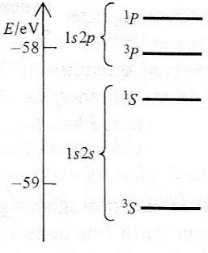
Helium Atom: Excited States
1s (1)1s (2) The spatial part is symmetric
1s (1)2s (2) or 1s (2)2s (1) symmetric nor anti-symmetric
1s (1)2s (2) + 1s (2)2s (1) Symmetric
1s (1)2s (2) - 1s (2)2s (1) Anti-symmetric

